Slide 1


Java is the name for both the programming language that can be used for developing complex web applications and for the software platform that used this programming language as its most important component. It shouldn’t be confused with JavaScript.

Slide 2
1
Modern Java Trends
Trends of Java
2
Real World Applications
How Java is making life easier
CONTENTS
Java Technologies
3
Java role in building Computer technologies
4
Java Jobs
Trends of Java Jobs

Slide 3
Chapter 1
Modern Java
Trends

Slide 4
Java Modern Trends
Frameworks
Dev Community
Industry
Reliable
Scalable
Large base of Frameworks
9 million Dev
Community
Standard for Industry application Development
Highly reliable and fast
JIT and other
Language support

Slide 5
Chapter 2
Real World
Applications

Slide 6
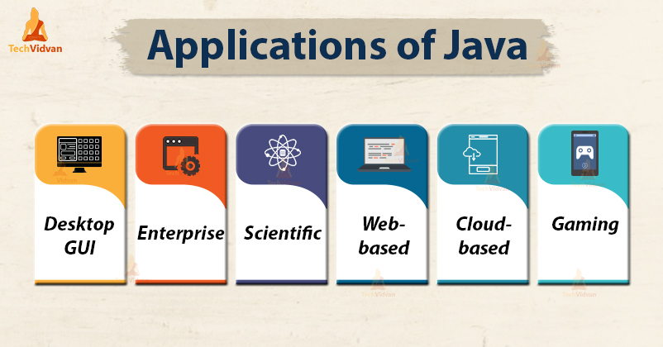

Slide 7

Java Technologies
Enterprise Applications
Mobile Application
Java Enterprise Edition (Java EE) is a very popular platform that provides API. Java EE platform is designed to help developers create large-scale, multi-tiered, scalable, reliable, and secure network applications.
Java is considered as the official programming language for mobile app development.
Desktop GUI Applications
Cloud-Based Applications
Java also provides GUI development capability through various means mainly Abstract Windowing Toolkit (AWT), Swing and JavaFX.
Java provides you with features that can help you build applications meaning that it can be used in the SaaS, IaaS and PaaS development.
Web-based Applications
Big Data technologies
Java is also used to develop web applications. It provides a vast support for web applications through Servlets, Struts or JSPs.
Java is the reason why the leading Big Data technologies like Hadoop have become a reality and also the most powerful programming languages like Scala are existing.

Slide 8
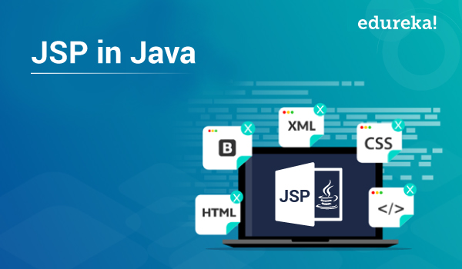
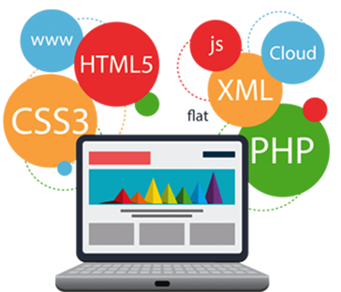
Java Technologies
The easy coding and high security offered by this programming language allow the development of a large number of applications for health, social security, education, and insurance.
Easy to maintain , Fast Development, Extension to Servlet.

Slide 9
Chapter 3
Java
Technologies

Slide 10
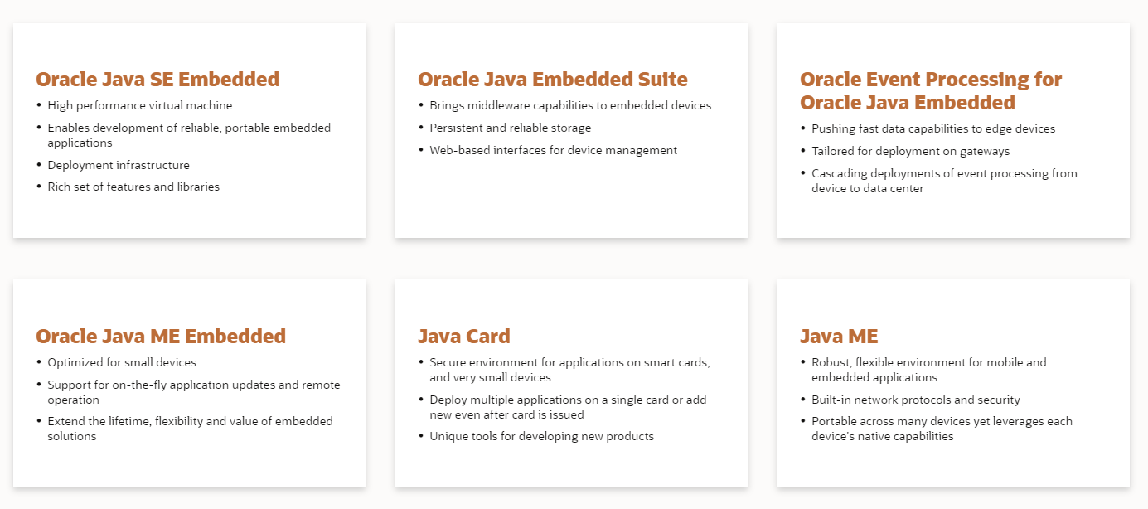
Java Technologies
Notes:
Java Platform, Micro Edition (Java ME)
Java Platform, Micro Edition (Java ME) provides a robust, flexible environment for applications running on embedded and mobile devices in the Internet of Things: micro-controllers, sensors, gateways, mobile phones, personal digital assistants (PDAs), TV set-top boxes, printers and more. Java ME includes flexible user interfaces, robust security, built-in network protocols, and support for networked and offline applications that can be downloaded dynamically. Applications based on Java ME are portable across many devices, yet leverage each device's native capabilities.
Java Platform, Micro Edition (Java ME) provides a robust, flexible environment for applications running on embedded and mobile devices in the Internet of Things: micro-controllers, sensors, gateways, mobile phones, personal digital assistants (PDAs), TV set-top boxes, printers and more. Java ME includes flexible user interfaces, robust security, built-in network protocols, and support for networked and offline applications that can be downloaded dynamically. Applications based on Java ME are portable across many devices, yet leverage each device's native capabilities.
Java Card enables secure elements, such as smart cards and other tamper-resistant security chips, to host applications which employ Java technology. Java Card offers a secure and interoperable execution platform that can store and update multiple applications on a single resource-constrained device, while retaining the highest certification levels and compatibility with standards.

Slide 11
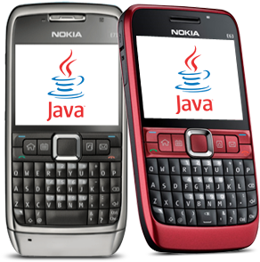

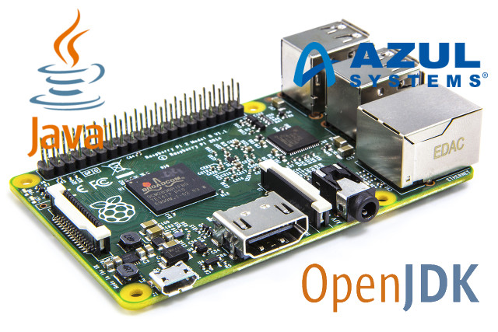



Java Technologies Application
Java Mobile Phones
Java Secure Cards
Java IoT Applications

Slide 12
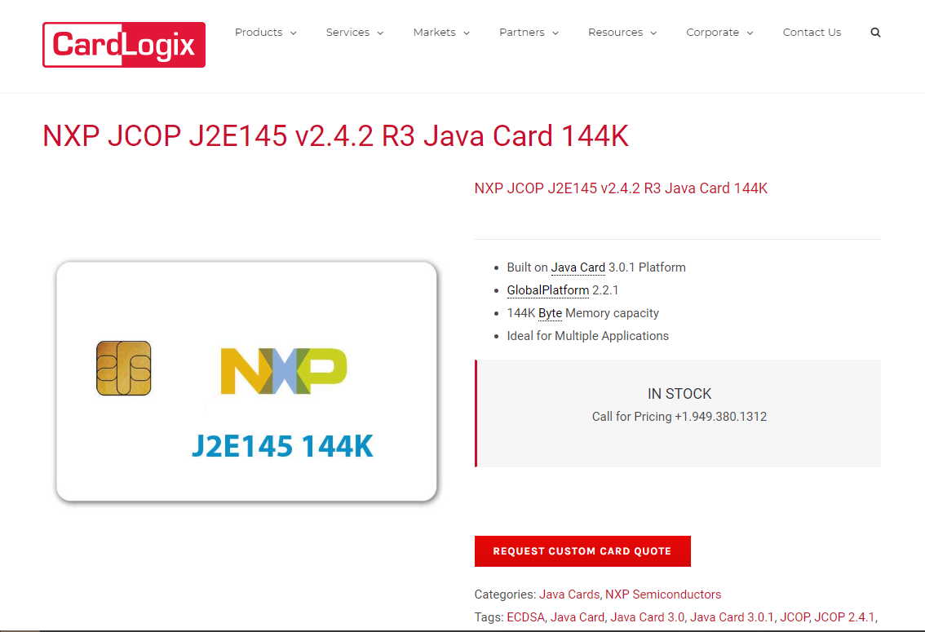

Slide 13
Chapter4
Jobs

Slide 14
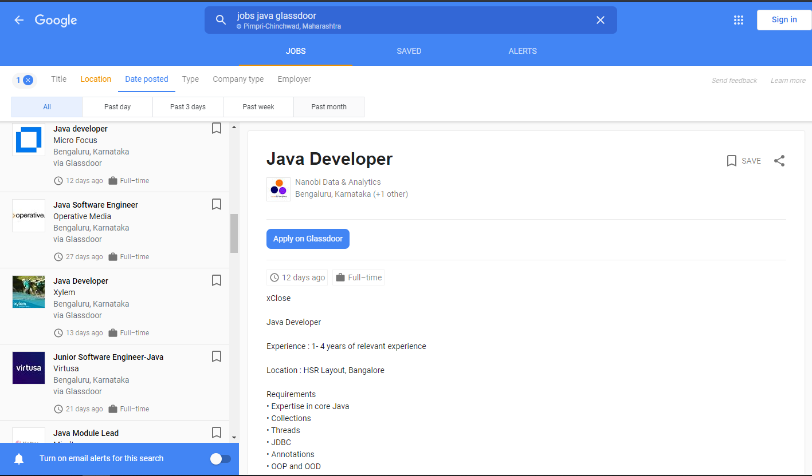

Java Job Trends
Jobs for JAVA in India
In India, the median would be 4.5 lakh per annum. It certainly pays to be a Java developer and skilled programmers are making good use of the opportunity. There are 9 million Java Developers the world over and the demand still continues to rise!

Slide 15

Top Java Jobs in IT Industry
Jobs for JAVA Full Stack
Jobs for JAVA
CLOUD
JAVA Freelancer

Slide 16

THANK YOU

